Slide 1
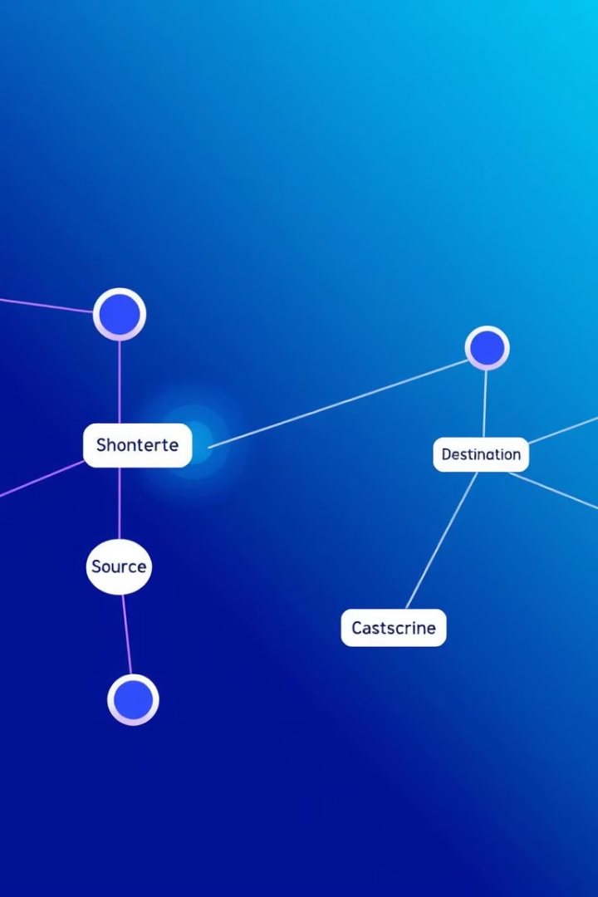
Dijkstra's Algorithm: Shortest Path
This presentation will explore Dijkstra's algorithm for finding the shortest path in a network.
By: Heet Mehta CST 22002171310055

Slide 2
Introduction to Network Routing and Shortest Path
Network routing is the process of selecting paths for data transfer within a network. This involves determining the most efficient route for data packets to travel from a source to a destination.
The shortest path problem aims to find the route between two points in a network that minimizes the total distance, cost, or time required to traverse it. This is a fundamental problem in computer networks, as it enables efficient communication and data delivery.

Slide 3

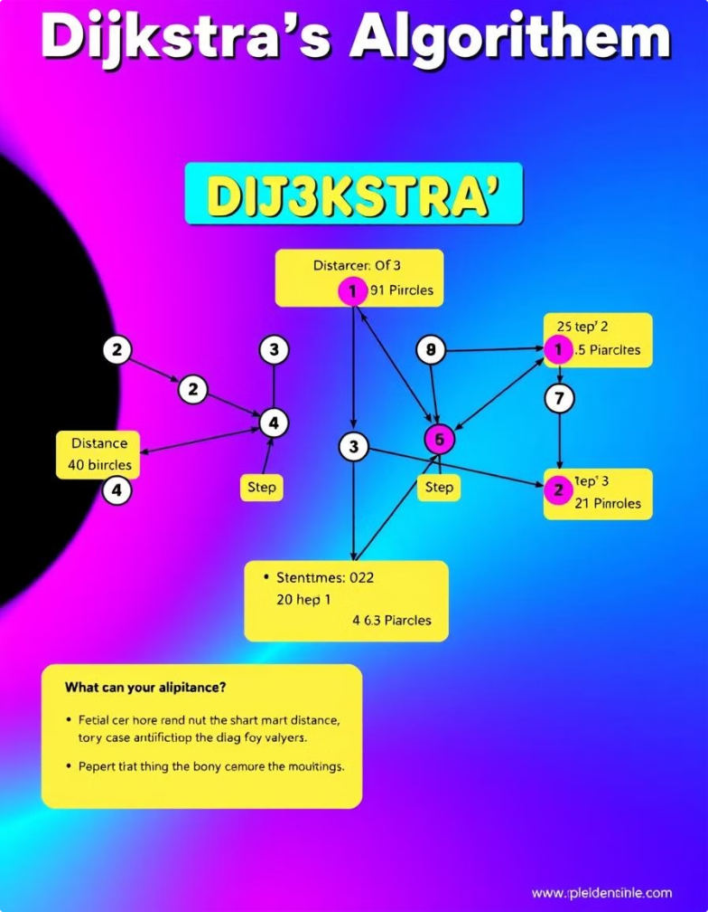
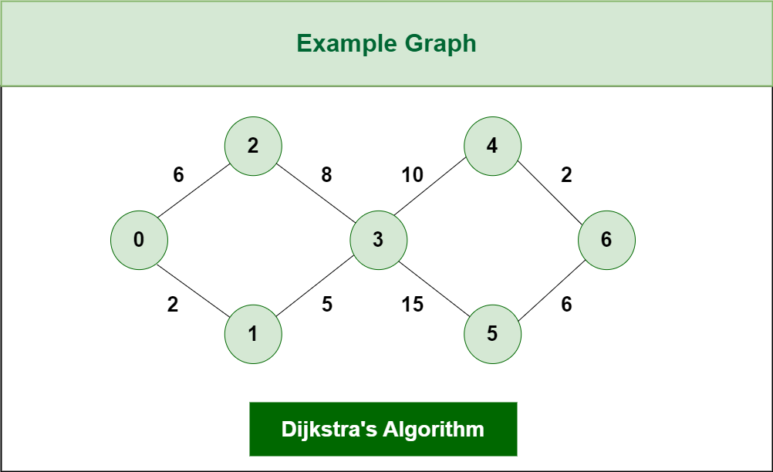
Dijkstra's Algorithm: Step-by-Step Explanation
1
Initialization: Set the distance to the starting node to 0 and all other nodes to infinity. Mark the starting node as visited.
2
Iteration: For each unvisited node, calculate the distance from the starting node via its unvisited neighbors. Choose the unvisited node with the shortest distance and mark it as visited.
3
Repeat: Continue this process until the destination node is visited. The distance to the destination node represents the shortest path length.

Slide 4


Advantages of Dijkstra's Algorithm
1
Efficiency
2
Optimality
Dijkstra's algorithm is known for its efficiency in finding the shortest path, even in complex networks with numerous nodes and edges.
It guarantees that the path found is indeed the shortest possible path, minimizing the cost or time required for data transfer.
3
Versatility
The algorithm can be applied to various network scenarios, including those with weighted edges, representing different costs or distances.

Slide 5
Implementation of Dijkstra's Algorithm (Pseudocode)
public static void dijkstra(int[][] adjacencyMatrix) { int v = adjacencyMatrix.length; boolean visited[] = new boolean[v]; int distance[] = new int[v]; for (int i = 0; i < v; i++) { distance[i] = Integer.MAX_VALUE; } distance[0] = 0; for (int i = 0; i < v - 1; i++) { int minVertex = findMinVertex(distance, visited); // vertex with min dist. visited[minVertex] = true; for (int j = 0; j < v; j++) { // for neighbors if (adjacencyMatrix[minVertex][j] != 0 && !visited[j]) { int newDist = distance[minVertex] + adjacencyMatrix[minVertex][j]; if (newDist < distance[j]) { distance[j] = newDist; } } } } for (int i = 0; i < v; i++) { System.out.println("Vertex " + i + " shortest distance is " + distance[i]); } } public static int findMinVertex(int[] distance, boolean visited[]) { int minVertex = -1; for (int i = 0; i < distance.length; i++) { if (!visited[i] && (minVertex == -1 || distance[i] < distance[minVertex])) { minVertex = i; } } return minVertex; }

Slide 6
Example: Calculating Shortest Paths in a Network
Source: Node 1
1
Starting at node 1, initialize distances and mark it as visited.
Iteration 1: Node 2
2
Choose node 2 as the closest unvisited neighbor of node 1, update distances, and mark it as visited.
Iteration 2: Node 3
3
Choose node 3 as the closest unvisited neighbor of node 2, update distances, and mark it as visited.
Iteration 3: Node 5
4
Choose node 5 as the closest unvisited neighbor of node 3, update distances, and mark it as visited.

Slide 7

Limitations and Considerations
Negative Edge Weights
Computational Complexity
Dijkstra's algorithm is designed for graphs with non-negative edge weights. Handling negative weights requires specialized algorithms.
For large networks, the time complexity of Dijkstra's algorithm can be a concern, especially without priority queues.
Dynamic Networks
Dijkstra's algorithm assumes static network conditions. In dynamic networks, where paths change frequently, it might not be the most efficient solution.

Slide 8

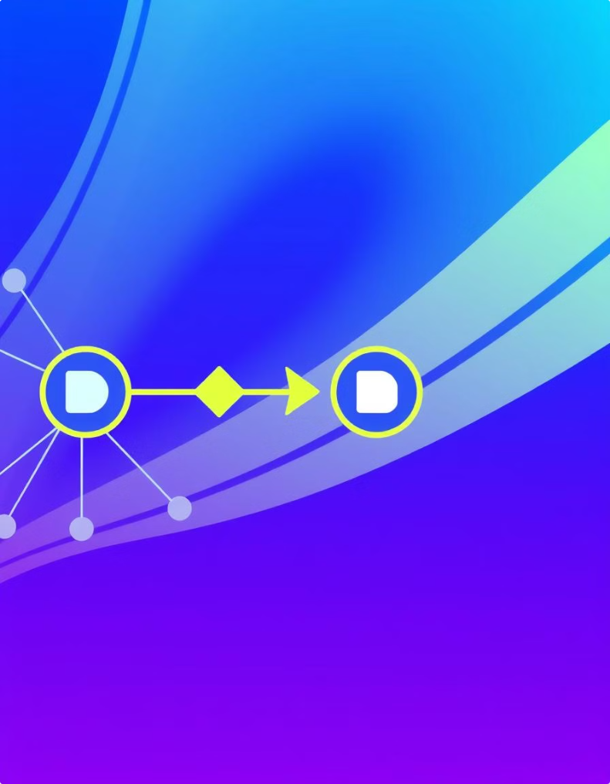



Conclusion and Key Takeaways
Network Routing
Dijkstra's algorithm provides a reliable method for finding the shortest path in a network, ensuring efficient data flow.
Efficiency and Optimality
By minimizing the distance or cost of data transfer, Dijkstra's algorithm optimizes communication and network performance.
Algorithm Understanding
Understanding the mechanics of Dijkstra's algorithm enables developers to build efficient and reliable network routing systems.

